Slide 1
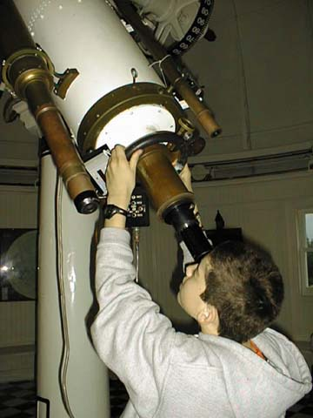
Cybermissions: Towards A Theology Of Technology
ICCM – Worship Session
John Edmiston

Slide 2
The Problem
Two of the main forces that are changing the world today are technological change and religious conflict. (Others include economic globalization, environmental challenges and corrupt and self-serving leadership)
These challenges interact and intersect with each other
Technological change threatens some religions more than others and intersects with globalization and the environmental issues.
Technological change is set to increase very rapidly
Artificial intelligence is already operating in some highly specialized areas (such as playing chess, translating languages and driving autonomous vehicles)
Biotechnology is at the point where the definition of what it even means to be human is constantly being challenged
A great gap is opening up between the technological have’s and have-nots

Slide 3

The Christian Response
Very few Christian pastors or theologians are addressing these issues or the challenges that we will face as we fully enter the Information Age
Some Christians are beginning to use technology to share the gospel and these efforts are gradually gathering momentum

Slide 4
Shift Happens: Video On Globalization
http://www.youtube.com/watch?v=ljbI-363A2Q

Slide 5
Some Of The Theological Issues
Robots & Humans
Robot Ethics
Databases & Privacy
Artificial Intelligence
Neural Implants & Human Personality
Artificial Transplants (how much of the human body can we replace and still be human)
Definitions of Mind/Body/Spirit
Intelligent avatars ?
Trans-Humanism
Post-Humanism
Genetic alteration of human personality
Abortion of people with “criminal genes”

Slide 6

Recent Books
Ray Kurzweil: The Age of Spiritual Machines; The Singularity Is Near
Richard Clarke – Breakpoint
Francis Fukuyama – Our Posthuman Future: Consequences of The Biotechnology Revolution
James Gardner – The Intelligent Universe

Slide 7
Technology: Good Or Evil?
The two extreme views are that:
a) technology is always good
b) technology is always evil.
Another view is that technology is about material objects and is therefore unspiritual and this is not the concern of the Church.
This is Greek Platonism (matter is evil and confining). However Christianity is about an incarnate Christ and a resurrected body and takes the transformation of the material world very seriously indeed.

Slide 8
The Holy Spirit & Technology
Bezalel was the first Spirit-filled person in the Bible
Bezalel was filled with the Spirit so that he could accomplish a technological task – building the Tabernacle
And Jehovah spoke to Moses, saying, Behold, I, I have called by name Bezaleel, the son of Uri, the son of Hur, of the tribe of Judah. And I have filled him with the spirit of God, in wisdom, and in understanding, and in knowledge, and in all workmanship, to devise designs; to work in gold, and in silver, and in bronze, and in cutting of stones, to set them, and in carving of timber, to work in all workmanship.
(Exodus 31:1-5 MKJV)

Slide 9
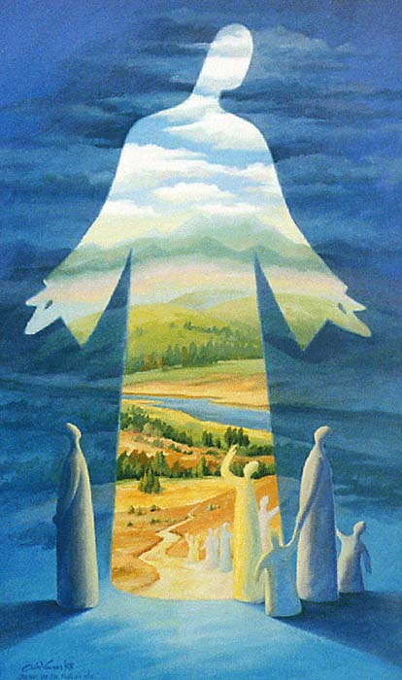
Jesus & Technology
Jesus did not incarnate as a monk, or a philosopher but as a carpenter – a creative, tool-using, technical person
Jewish rabbis had to learn a trade e.g. Paul was a tentmaker
The disciples were “hands-on” people (fishermen etc)
This means we need to redefine spirituality to include some measure of technical ability!
Contrast between Jesus’ followers / methods & that of Greek philosophers

Slide 10
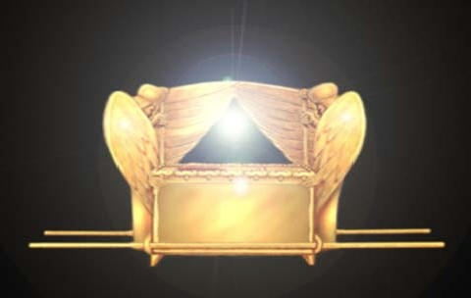
God & The Ark Of The Covenant
And you shall put the mercy-seat above, upon the ark. And in the ark you shall put the testimony that I shall give you. And I will meet with you there, and I will talk with you from above the mercy-seat, from between the two cherubs on the ark of the testimony, of all things which I will give you in commandment to the sons of Israel.
(Exodus 25:21-22 MKJV)
God put His Presence and Voice in a human creation made by a craftsman – God-indwelt technology?

Slide 11

Spirit-Indwelt Machines
And as I looked at the living creatures, behold, one wheel was on the earth by the living creatures, with its four faces. And their appearance and their workmanship was like a wheel in the middle of a wheel. When they went, they went on their four sides; and they did not turn when they went. And their rims: they were even high; they were even awesome. And their rims were full of eyes all around the four of them. And in the going of the living creatures, the wheels went beside them; and in the lifting up of the living creatures from the earth, the wheels were lifted up. Wherever the spirit was to go, there they went; there the spirit was to go, and the wheels were lifted up along with them. For the spirit of the living creature was in the wheels. In their going, these went; and in their standing still, these stood still. And in their lifting up from the earth, the wheels were lifted up along with them. For the spirit of the living creature was in the wheels. (Ezekiel 1:15-21 MKJV)

Slide 12
Demons In The Machine….
Rev 13:15 And there was given to it to give a spirit to the image of the beast, so that the image of the beast might both speak, and might cause as many as would not worship the image of the beast to be killed.
And a third angel followed them, saying with a great voice, If anyone worships the beast and its image, and receives a mark in his forehead or in his hand, he also will drink of the wine of the anger of God, having been mixed undiluted in the cup of His wrath. And he will be tormented by fire and brimstone before the holy angels, and in the presence of the Lamb.
(Revelation 14:9-10 MKJV)

Slide 13
Idols and Artifacts
Idols and religious artifacts can carry a demonic presence
What then do I say? That the idol is anything, or that an idolatrous sacrifice is anything? But I say that the things which the nations sacrifice, they sacrifice to demons and not to God. And I do not desire that you should have fellowship with demons. (1 Corinthians 10:19-20 MKJV)
And He shall deliver their kings into your hand, and you shall destroy their name from under the heavens. No man shall be able to stand before you until you have destroyed them. You shall burn the graven images of their gods with fire. You shall not desire the silver or gold on them, nor take it for yourself, so that you may not be snared in it. For it is an abomination to Jehovah your God. And you shall not bring an abomination into your house, lest you be a cursed thing like it. You shall utterly hate it, and you shall utterly despise it. For it is a cursed thing. (Deuteronomy 7:24-26 MKJV)

Slide 14

Good Technology Is…
Like the Ark or Ezekiel’s Wheels..
Worshipful / Glorifies God
Beautiful, Holy and Glorious
Lasting / Permanent
High Quality In Materials and Construction
Raises People Up To God
Blesses Them In Some Way
Gentle / Life-Giving
Revelatory
An Exercise In Grace And Mercy

Slide 15
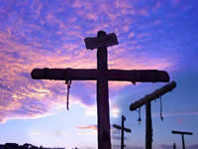
Evil Technology Is…
Like torture, crucifixion or the Image Of The Beast
Crude
Cruel / Degrading of Humanity
Inhuman / Beastly
Idolatrous
Murderous
Demonic
An Exertion Of Power & Dominance
Scornful Of God

Slide 16

So Then….
Christians should seek to develop ‘good technology’ and refuse to be involved in ‘evil technology’ no matter how cool it may first appear to be.
Christians should use technology to exalt God and to worship Him
Christians should use technology to help the poor and to achieve justice
Christians should use technology to share the gospel and to make disciples
Christians should use technology to create beauty, wisdom, knowledge and peace in the world around them
Christians should use technology to include people in loving Christian community

Slide 17
We Can Do This By….
Evaluating IT projects by their ethical nature and their gospel impact
Studying new technologies to see how they can be used to help others and to advance the Kingdom of God
Finding Kingdom needs that we can meet via technology
Thinking of those who have yet to hear the gospel
Making technology our servant and not our master
Being actively involved in our church and in prayer, bible study, worship and personal quiet times

Slide 18

The Challenges
For Christians to be ethically and constructively engaged with technology
To use technology to spread the gospel
To do high quality work that partakes of the ‘beauty of holiness’ as Spirit-filled craftsmen of God
To be at the forefront of new technologies so their initial use is redemptive
To offer non-violent resistance to the wrong uses of technology

